Slide 1
X.509 Authentication Service/ Digital Certificate

Slide 2
Title and Content Layout

Slide 3
What is a Digital Certificate?
A Digital Certificate is an electronic "password" that allows a person, organization to exchange data securely over the Internet using the public key infrastructure (PKI). Digital Certificate is also known as a public key certificate or identity certificate.
The certificate includes information about the key, information about the identity of its owner (called the subject), and the digital signature of an entity(CA) that has verified the certificate's contents (called the issuer).
If the signature is valid, and the software examining the certificate trusts the issuer, then it can use that key to communicate securely with the certificate's subject.
The most common format for digital certificates is defined by X.509.

Slide 4
Certification Authority
The certification authority (CA) is an entity that issues digital certificates.(the issuer)
A CA acts as a trusted third party-trusted both by the owner (the subject) of the certificate and by the party relying upon the certificate.
One particularly common use for certification authorities is to sign certificates used in HTTPS, the secure browsing protocol for the World Wide Web.

Slide 5
Introduction to X.509 Certificates
X.509 is a standard defining the format of Digital certificates.
X.509 is defined by the International Telecommunications Union's Standardization sector (ITU-T)
An X.509 certificate contains a public key and an identity (a hostname, or an organization, or an individual), and is either signed by a certificate authority or self-signed.

Slide 6
More about X.509 Certificate
X.509 was initially issued on July 3, 1988 and was begun in association with the X.500 standard.
X.509 certificates are used in many Internet protocols, including TLS(Transport Layer Security)/SSL(Secure Sockets Layer), which is the basis for HTTPS, the secure protocol for browsing the web.
3 versions are released by now, latest version is X.509 v3

Slide 7
X.509 Public-key Certificate Format
The general format for the certificate is: 
Version V
Serial Number SN
Signature algorithm identifier AI
Issuer Name CA
Period of Validity Ta
Subject Name A
Subject’s Public-Key Information Ap
Issuer Unique Identifier (in Ver.2)
Subject Unique Identifier (in Ver.2)
Extensions (in Ver.3)
Signature

Slide 8
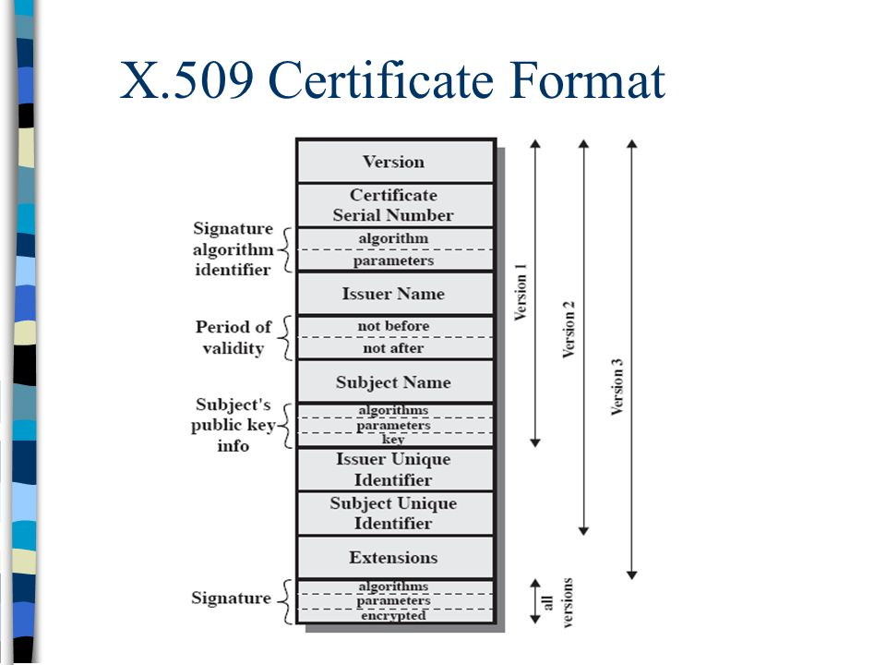
X.509 Public-key Certificate Formats

Slide 9
X.509 Standard Notation
User certificates generated by a CA use the following standard notation:
CA<<A>> = CA {V, SN, AI, CA, Ta, A, Ap}
Y<<X>> = the certificate of user X issued by the certification authority Y
Y {X} = the signing of X by Y consisting of X with an encrypted hash code appended.

Slide 10
Certificate filename extensions
Extensions were introduced in version 3.
A CA can use extensions to issue a certificate only for a specific purpose (e.g. only for signing digital objects)
There are several commonly used filename extensions for X.509 certificates.
.pem – (Privacy-enhanced Electronic Mail) Base64 encoded DER certificate, enclosed between "-----BEGIN CERTIFICATE-----" and "-----END CERTIFICATE-----"
.cer, .crt, .der – usually in binary DER form, but Base64-encoded certificates are common too (see .pem above)
.p7b, .p7c – PKCS#7 SignedData structure without data, just certificate(s) or CRL(s)
.p12 – PKCS#12, may contain certificate(s) (public) and private keys (password protected)
.pfx – PFX, predecessor of PKCS#12 (usually contains data in PKCS#12 format, e.g., with PFX files generated in IIS)

Slide 11
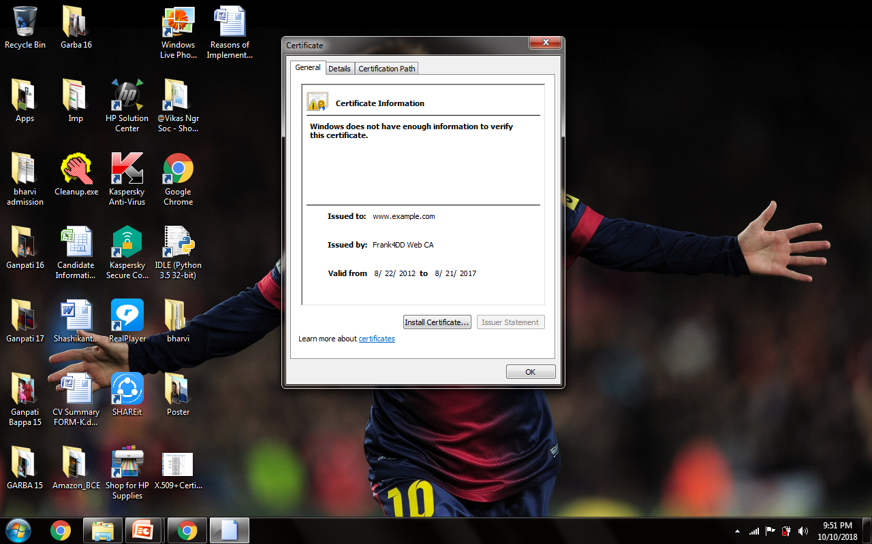
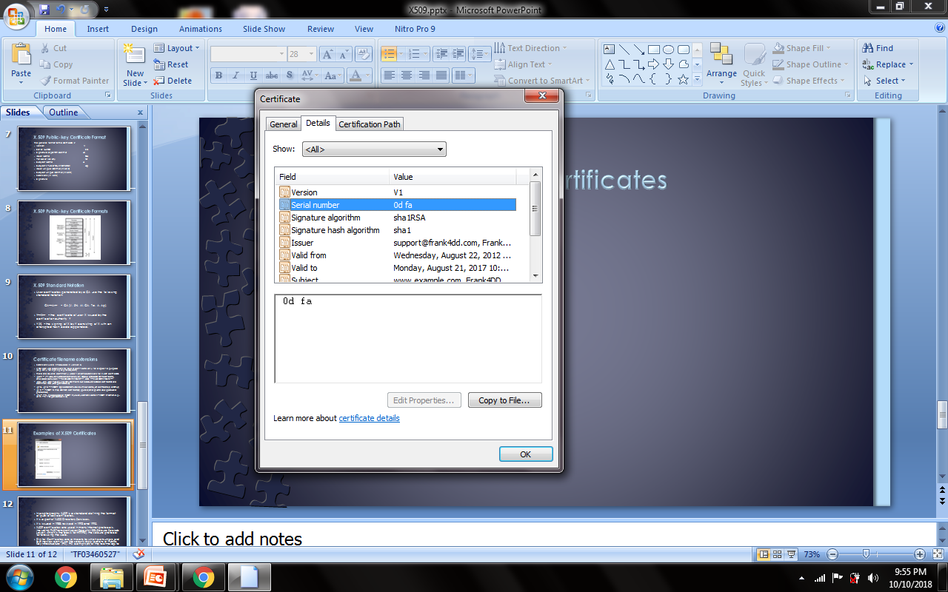
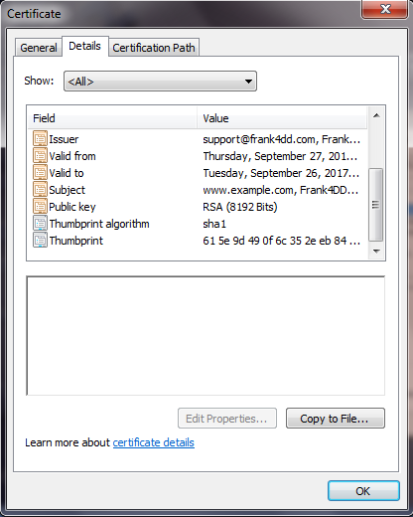
Examples of X.509 Certificates

Slide 12
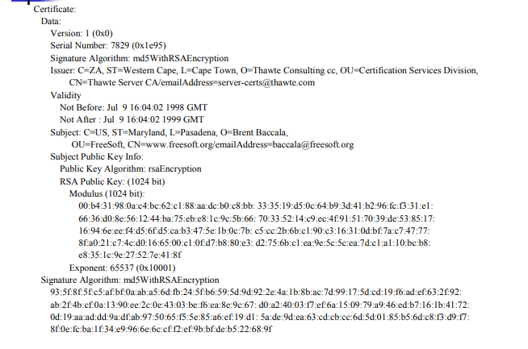
Examples of X.509 Certificate

Slide 13
Advantages of Digital Certificates
The biggest advantages of digital certificate-based authentication are privacy-based.
By encrypting your communications — emails, logins or online banking transactions — digital certificates protect your private data and prevent the information from being seen by unintended eyes.
Digital certificate systems are also user-friendly, usually working automatically and requiring minimal action or involvement from either senders or recipients.
Many IT organisation states that certificate servers are cheaper and easier to manage than other certificate authorities or systems used for encryption.

Slide 14
Disadvantages of Digital Certificates
While the idea of digital certificates is to block outsiders from intercepting your messages, the system is not an infallible one.
Since certificate authorities are the ones in charge of issuing digital certificates, hackers often target these authorities in order to manipulate certificate information.
As a result, when a certificate authority is compromised, hackers can create websites or send emails that look genuine and pass certification tests, but are actually fraudulent.

